Slide 1

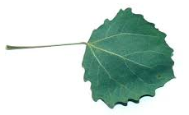
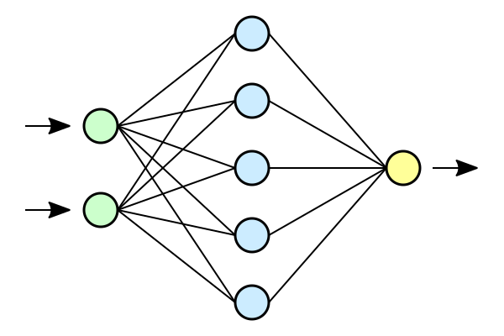
Unbe-leaf-able AI
By: Lucas Liebermann, Michael Li, Ezekiel Franklin,
Amelia Zheng, Nathaniel Wu, and Grace Magny-Fokam
Populus Tremula

Slide 2
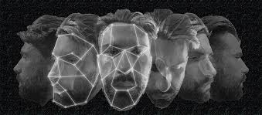
Overview of Image Recognition
Image Recognition is an example of machine learning where computers are able to identify objects by comparing objects to established objects.
The algorithm scans the image for colors and pixel size and translates these details into numbers that the computer can understand. With these patterns of characteristics, AI can classify the image by comparing it to the characteristics of a trained image.
EF

Slide 3

Neural Networks
A neural system is a artificial system that is based on the human brain. It includes a series of algorithms that recognizes relationships between data. It clusters and classifies the data and is always learning and improving.
EF

Slide 4
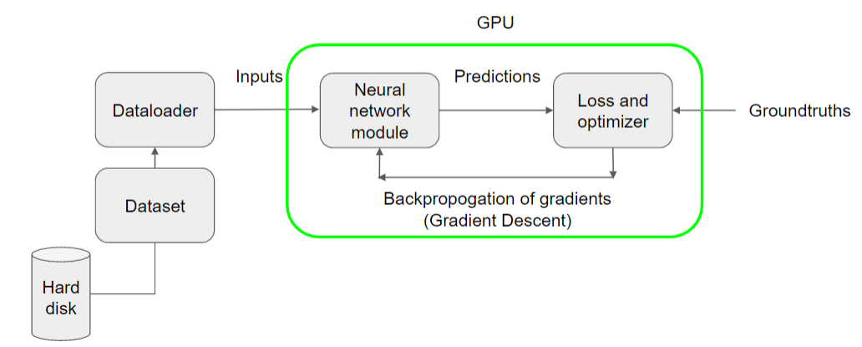
Overview of Image Recognition Training Pipeline
EF

Slide 5
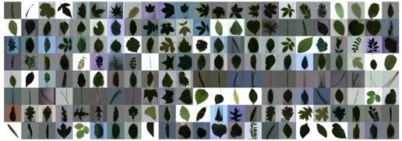
Project Introduction
The goal of our leaves or “Unbe-leaf-able AI” project was to see if a computer can use neural networks and image recognition to correctly identify the species of leaves via feature extraction.
We used the leafsnap dataset, which contains more than 20,000 image samples of all 185 leaf species.
GM/EF
Notes:
The goal of our leaves project was to see if a computer can use neural networks and image recognition to correctly identify the species of leaves. In the image below, you can see the different leaves that are in our dataset.

Slide 6
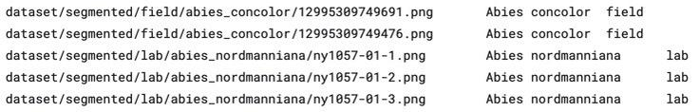
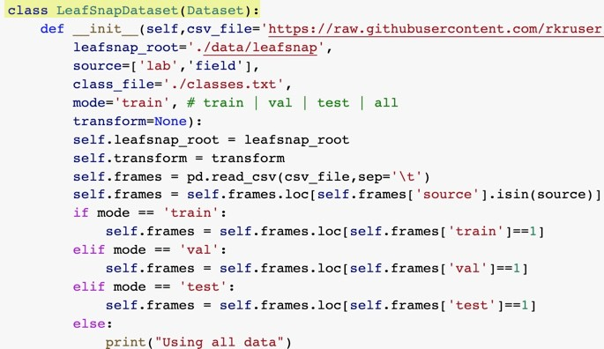
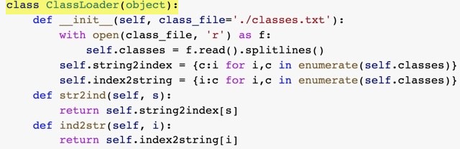
Dataset and DataLoader
We first downloaded the leafsnap dataset and defined it. We then defined and used the DataLoader to load data from the dataset. We also set training parameters so that the algorithm could begin training, or learning, from the dataset.
Leafsnap Dataset file
Dataset class
DataLoader class
GM/NW
Notes:
We downloaded the leafsnap dataset and defined it. We then defined and used the DataLoader to load data from the dataset. We also set training parameters so the algorithm could begin learning from the dataset.

Slide 7
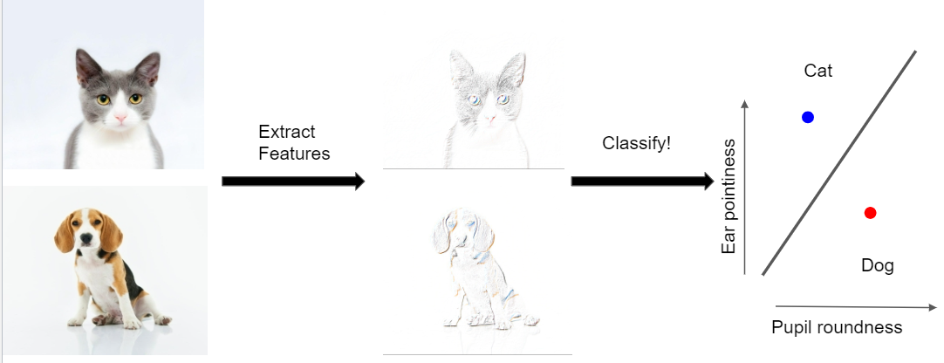
The Neural Network Model
NW

Slide 8

Checkpoint
NW

Slide 9
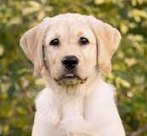


Feature Extraction
We identify images through features!
Can you identify a few features?
NW

Slide 10

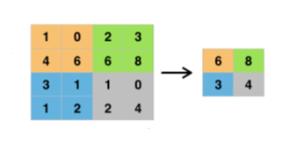

How Computers Do It
Convolution Goes over each region in the image, and extracts the information Define parameters to create a convolution filter | 2. ReLU Adds non-linearity to the network Increases power of the classifier Changes any negative numbers to 0 | 3. Max Pool Large images can be hard to handle for a computer Max Pooling reduces the dimensions of an image
Batchnorm Goes in between Convolution and ReLU Normalizes the range of values for the features at each layer Reduces the training time and increases the convergence speed for the neural network
Examples include: Resnet18, VGG11, and VGG11 with Batchnorm
NW

Slide 11
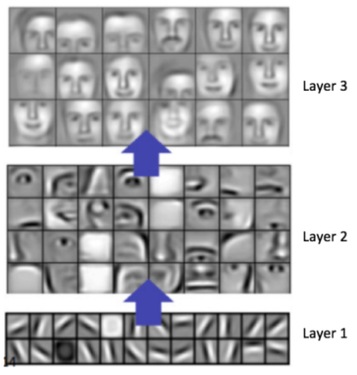
Visual of Feature Extraction
NW

Slide 12

Checkpoint
Convolution
Batchnorm
ReLU
Max Pool
NW

Slide 13


Classification
Use Fully connected layers (FC) to map the extracted features to the output predicted class (ex. Dog)
Each hidden layer has a set of nodes that connect to the layer before and after it
Classification is a probability of certainty for possible outputs
We can adjust the weights in the layers to classify better (closer to 100%)
70%
30%
FC Layers
NW

Slide 14
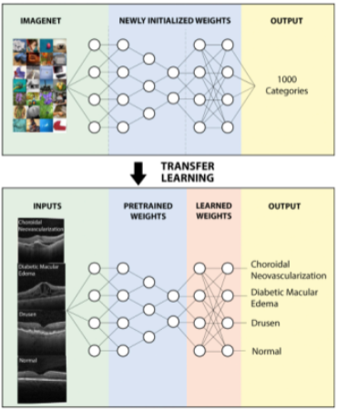

Transfer Learning
We can take pretrained weights and use them to speed up the learning process!
For this project, we can use ImageNet’s pretrained weights
Transfer Learning
Learning from Scratch
NW

Slide 15
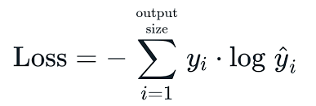
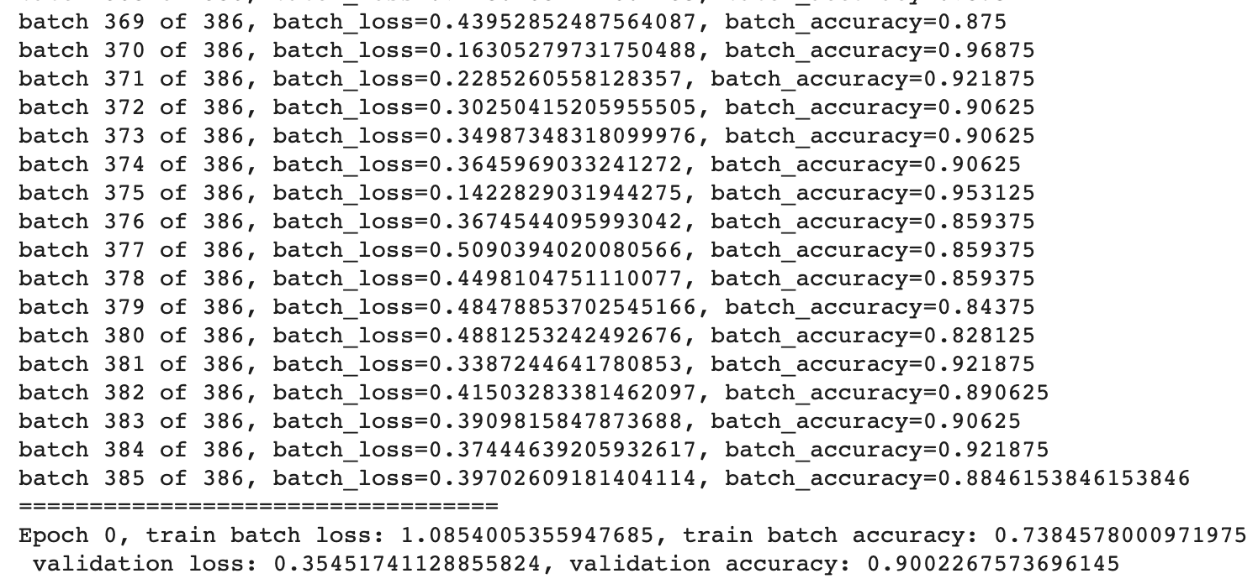
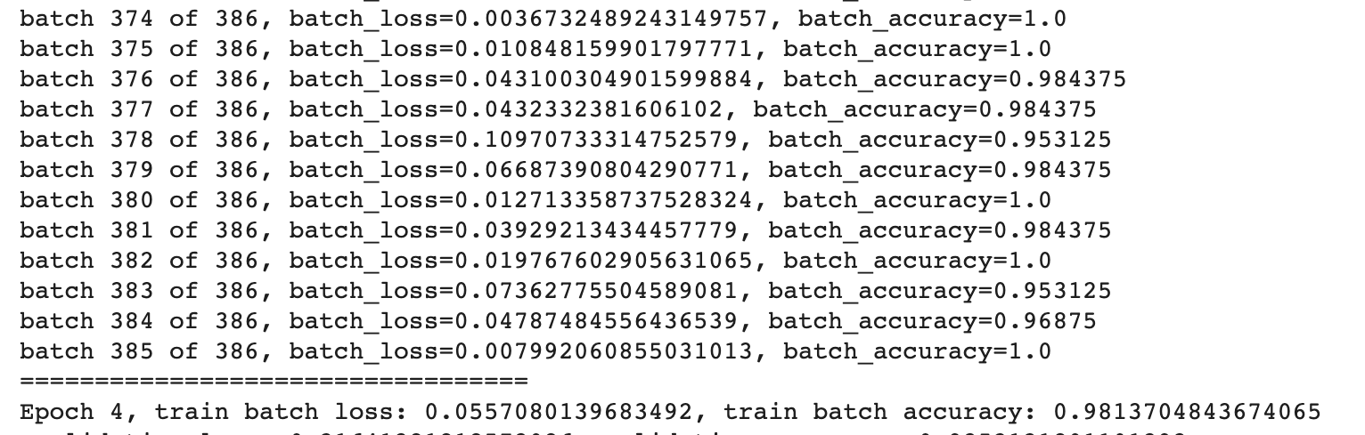
Training-Loss and Optimization
Objective during training of a neural network is to minimize the loss function
Loss function ~ cross entropy loss
Tells us how good our classifier is
The lower, the more accurate the predictions
Loss of 0 means the prediction is perfect
Can decrease the loss by increasing the number of epochs
Optimizers are algorithms or methods used to change attributes of the neural network such as weights and learning rate in order to reduce the loss
Learning rate = 0.0001
Hyperparameter used in training neural networks
Epoch = Going through the dataset once
AZ
Epoch 0 for VGG11
Epoch 4 for VGG11

Slide 16
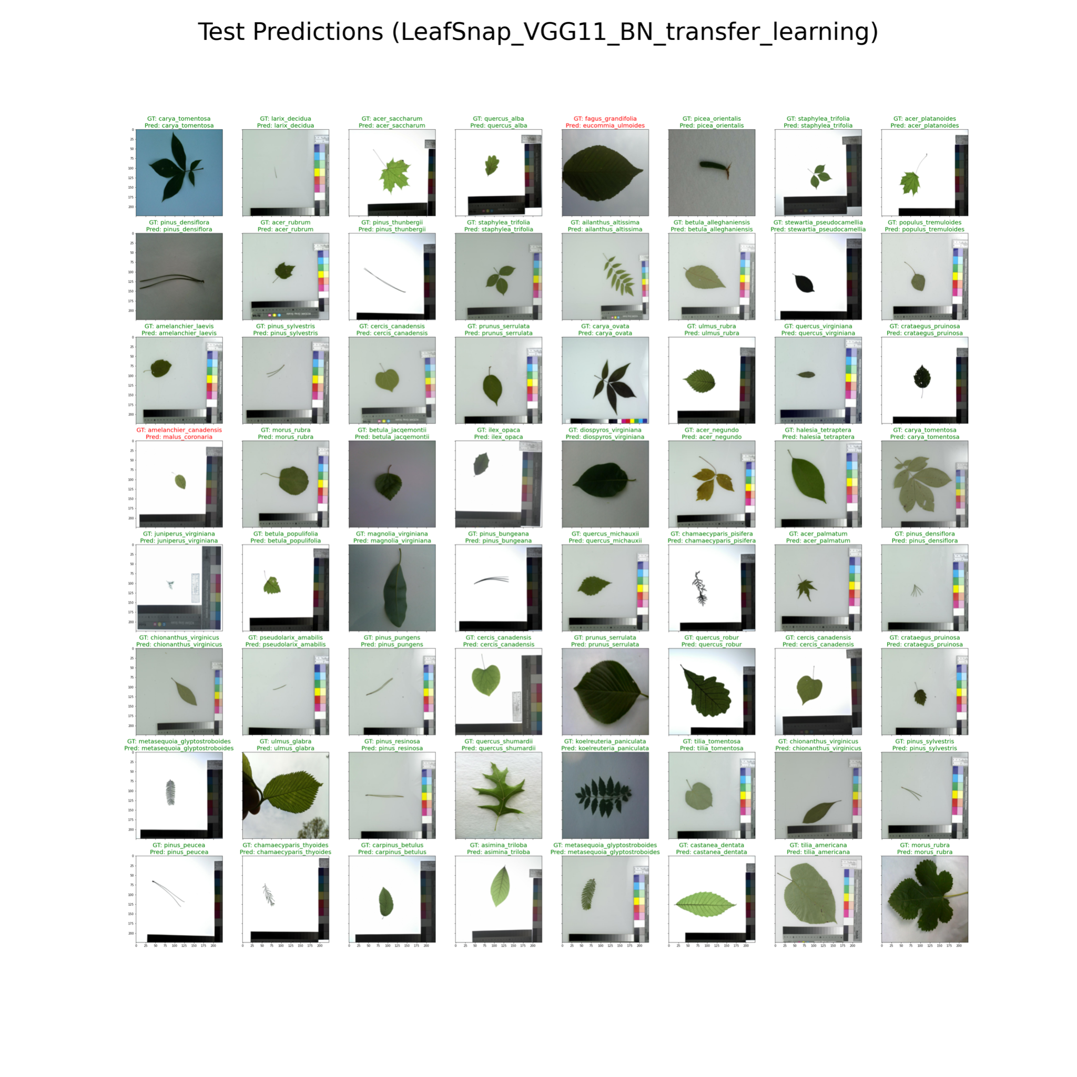
Results for VGG11_BN and transfer learning
AZ

Slide 17
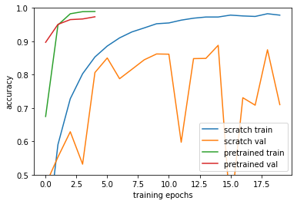
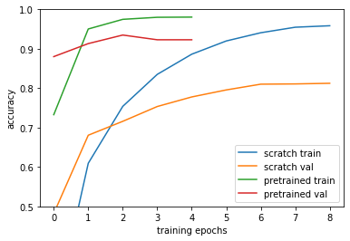
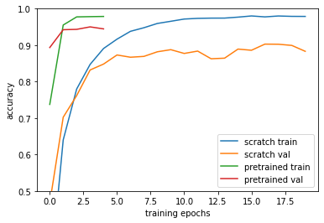
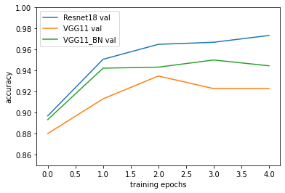
Accuracy in Various Models
Resnet 18 Pretrained vs Training from Scratch | VGG 11 Pretrained vs Training from Scratch
VGG11_BN Pretrained vs Training from Scratch | Resnet 18 vs VGG 11 vs VGG 11_BN (All Pretrained)
LL

Slide 18
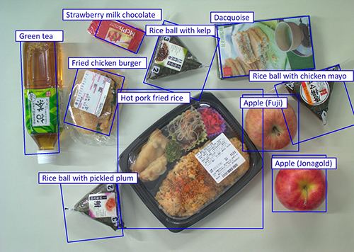
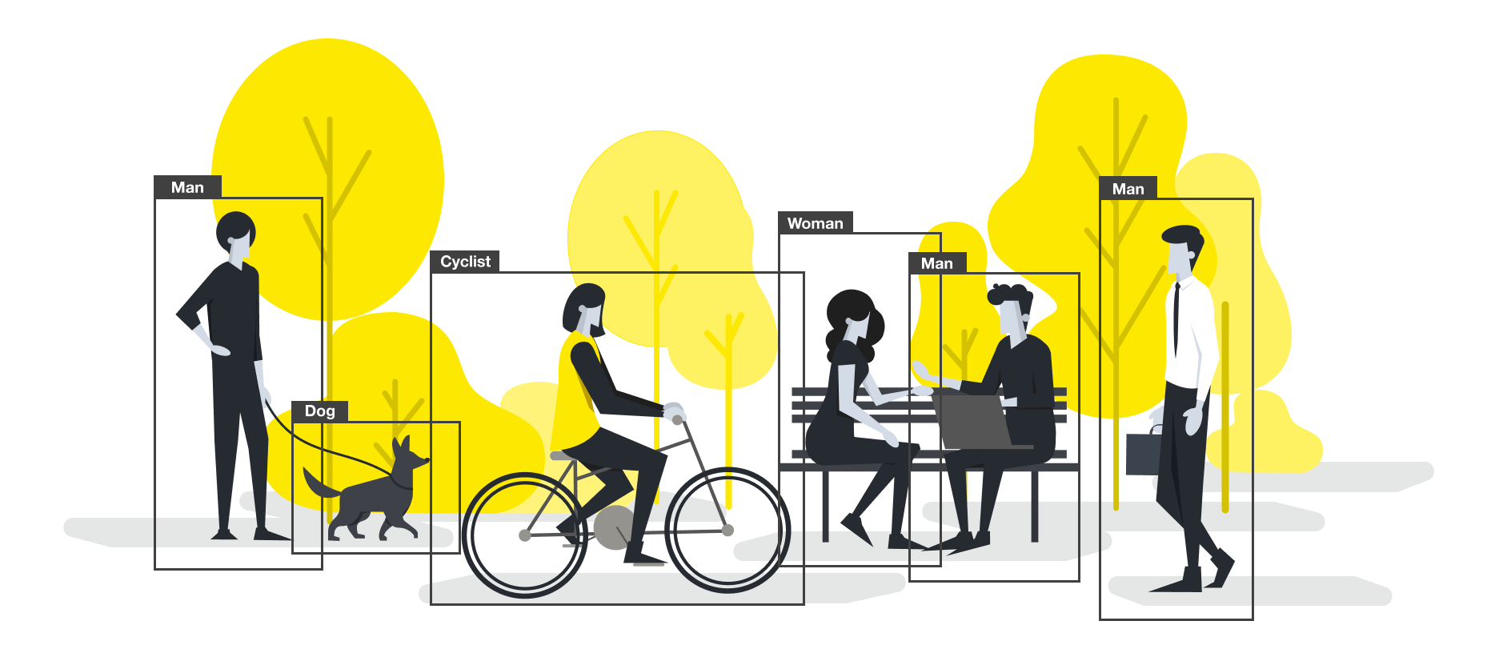
Real World Applications
How can this be used in real life?
People can use image recognition to recognize different animal and plant species.
Doctors can use image recognition to recognize diseases
Identifying people, places, and things
ML

Slide 19

Acknowledgements
Faculty:
Koutilya PNVR
Daniel Lichy
David Jacobs
AI4ALL Facilitators:
Nora Blasko
Harpreet Multani
Maryann Vazhapilly
Abril Arias
Sarah Flores
ML

Slide 20
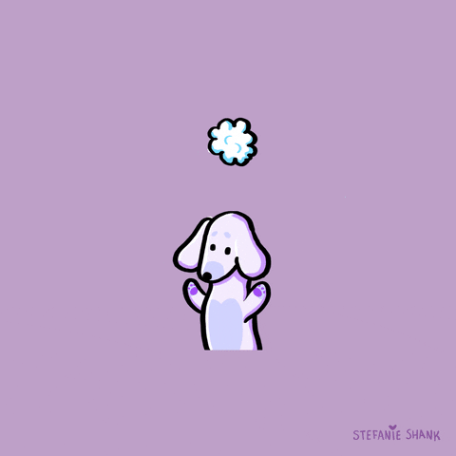
Thanks for Listening!

Slide 21
Image source
https://www.goodhousekeeping.com/home/gardening/g2681/plant-leaves/ (Leaves banner)
https://www.guidedogs.org/
https://timesofindia.indiatimes.com/life-style/relationships/pets/5-things-that-scare-and-stress-your-cat/articleshow/67586673.cms

